Slide 1
Design Patterns
Introduction to Software Engineering
FAST-NU-CFD

Slide 2
Design Patterns
Design patterns were derived from ideas put forward by Christopher Alexander who suggested that
there were certain common patterns of building design that were inherently pleasing and effective.

Slide 3
Outline
Introduction to design patterns
Creational Design Patterns
Structural Design Patterns
Behavioral Design Patterns

Slide 4
Design Pattern
The pattern is a
description of the problem and
the essence of its solution,
so that the solution may be reused in different settings.
The pattern is not a detailed specification.

Slide 5
Design Pattern
Design patterns are:
Patterns and Pattern Languages are ways to describe best practices, good designs, and capture experience in a way that it is possible for others to reuse this experience.

Slide 6
Design Pattern
Design patterns are usually associated with object-oriented design.
Published patterns often rely on object characteristics such as inheritance and polymorphism to provide generality.
The general principle of encapsulating experience in a pattern is one that is equally applicable to any kind of software design.
So, you could have configuration patterns for COTS systems.
Notes:
e.g. Dog class inherits the Animal class.
polymorphism is the ability of a message to be displayed in more than one form. A real-life example of polymorphism, a person at the same time can have different characteristics. Like a man at the same time is a father, a husband, an employee.

Slide 7
Gang Of Four (GoF) Design Patterns
Named after the four authors of book.
Developed by Erich Gamma, Richard Helm, Ralph Johnson, and John Vlissides.
The GOF design patterns are
“descriptions of communicating objects and classes that are customized to solve a general design problem in a particular
context.”

Slide 8
The four essential elements of design patterns were defined by the ‘Gang of Four’ in their patterns book:
A name that is a meaningful reference to the pattern.
A description of the problem area that explains when the pattern may be applied.
A solution description of the parts of the design solution, their relationships, and their responsibilities.
This is not a concrete design description. It is a template for a design solution that can be instantiated in different ways. This is often expressed graphically and shows the relationships between the objects and object classes in the solution.
A statement of the consequences—the results and trade-offs—of applying the pattern.
This can help designers understand whether or not a pattern can be used in a particular situation.
Notes:
Name – A simple, meaningful name for the pattern.
Description – Explains when and where to use the pattern.
Solution – Describes how the pattern solves a design problem, often with diagrams.
Consequences – Lists the benefits and trade-offs of using the pattern.

Slide 9
Design Patterns
To use patterns in your design, you need to recognize that any design problem you are facing may have an associated pattern that can be applied.
Examples of such problems, documented in the ‘Gang of Four’s original patterns book, include:
Tell several objects that the state of some other object has changed (Observer pattern).
Tidy up the interfaces to a number of related objects that have often been developed incrementally (Façade pattern).
Provide a standard way of accessing the elements in a collection, irrespective of how that collection is implemented (Iterator pattern).
Allow for the possibility of extending the functionality of an existing class at run-time (Decorator pattern).

Slide 10
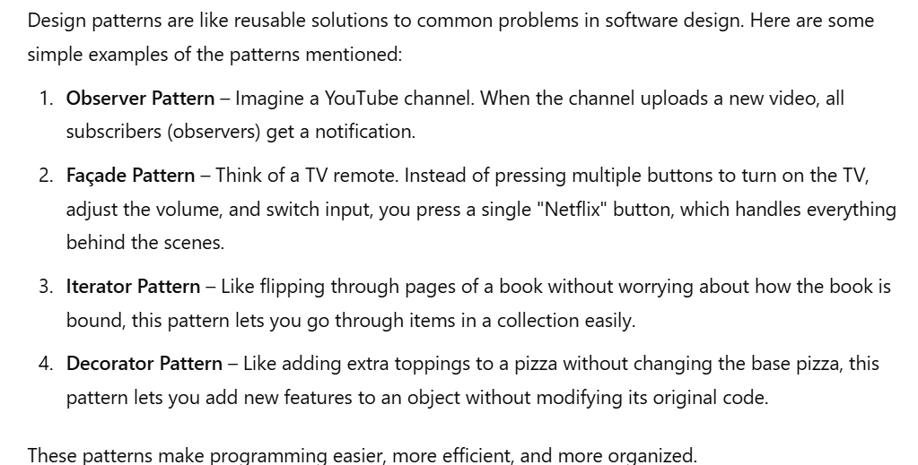

Slide 11
Gof Design Patterns Classification
Creational
Concern the process of object creation.
Structural
deal with the composition of classes or objects.
Behavioral
characterize the ways in which classes or objects interact and distribute responsibility.

Slide 12
Scope of Patterns
Scope specifies whether the pattern applies primarily to classes or to objects.
Class patterns deal with relationships between classes and their subclasses.
These relationships are established through inheritance, so they are static—fixed at compile-time.
Object patterns deal with object relationships, which can be changed at run-time and are more dynamic.
Notes:
An object is an instance of a class. Class − A class can be defined as a template/blueprint that describes the behavior/state that the object of its type support.

Slide 13
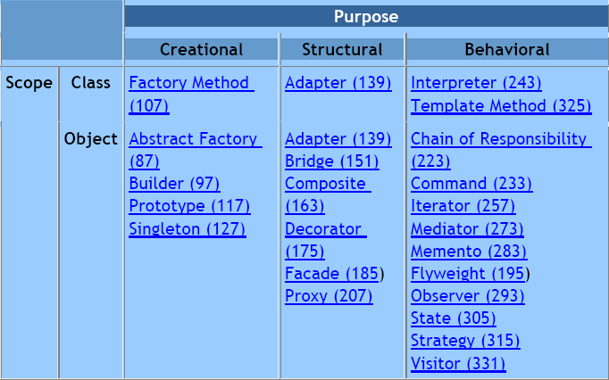

Slide 14
Creational Patterns
Creational class patterns:
defer some part of object creation to subclasses
Creational object patterns:
defer it to another object.

Slide 15
Structural Patterns
Structural class patterns:
use inheritance to compose classes
Structural object patterns:
describe ways to assemble objects.

Slide 16
Behavioral Patterns
Behavioral class patterns:
use inheritance to describe algorithms and flow of control
Behavioral object patterns:
describe how a group of objects cooperate to perform a task that no single object can carry out alone.

Slide 17
Singleton

Slide 18
Singleton objects
Intent
Ensure a class only has one instance, and provide a global point of access to it
Motivation
Some classes have conceptually one instance
Many printers, but only one print spooler
One file system
One window manager
only create one object and reuse it
Encapsulate the code that manages the reuse
Notes:
In languages that create objects from classes, an object is an instantiation of a class. That is, it is a member of a given class that has specified values rather than variables. In a non-programming context, you could think of "dog" as a class and your particular dog as an instance of that class.

Slide 19
The Singleton solution
Class is responsible for tracking its sole instance
Provide static method/field to allow access to the only instance of the class
Benefit:
Reuse implies better performance
Class encapsulates code to ensure reuse of the object; no need to burden client

Slide 20
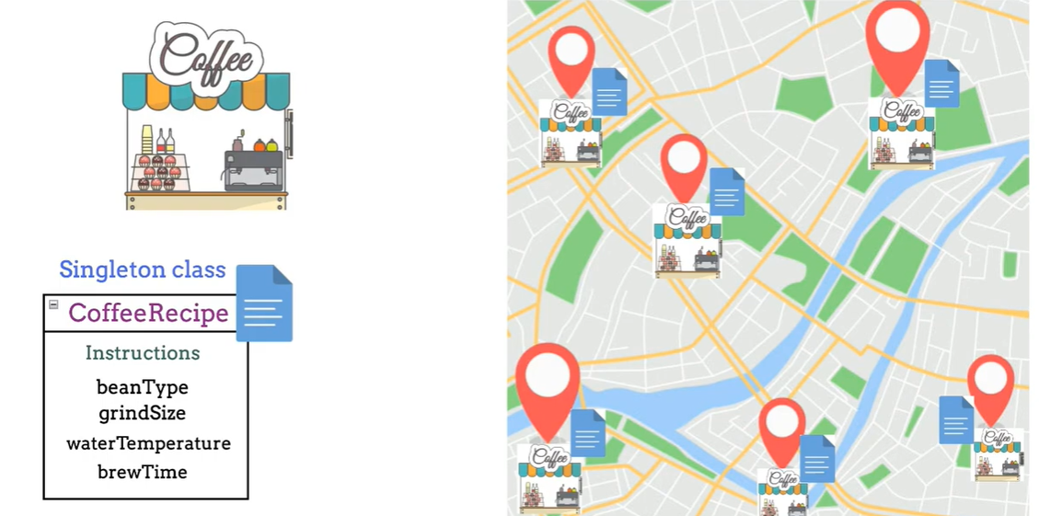

Slide 21
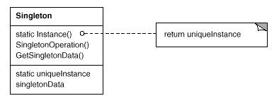
Singleton pattern Structure

Slide 22
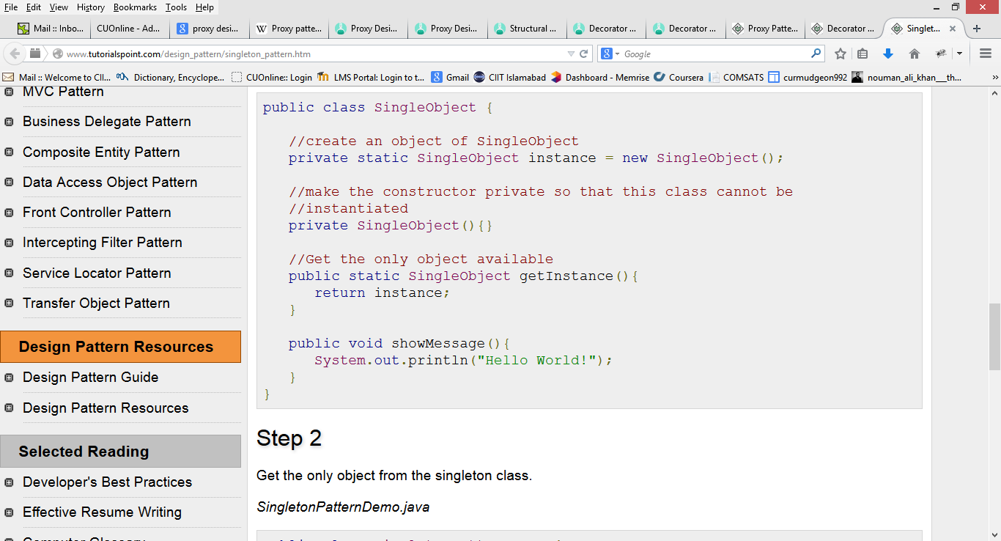

Slide 23
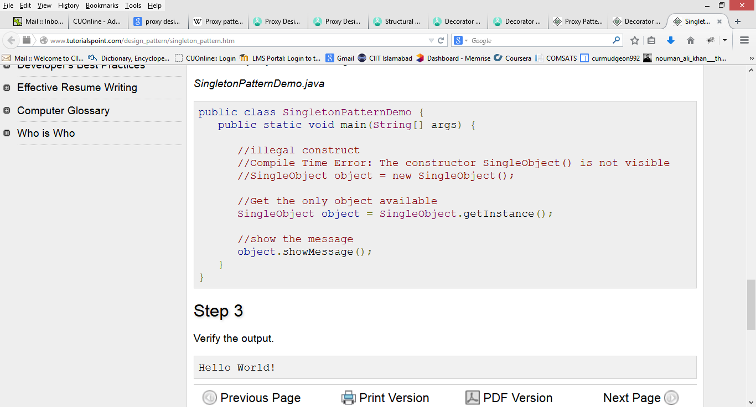

Slide 24
Singleton Design Pattern
Sometimes, there may be a need to have one and only one instance of a given class during the lifetime of an application.
This may be due to necessity or, more often, due to the fact that only a single instance of the class is sufficient
For example maintaining single database connection, registry values etc

Slide 25
Application of Singleton
In environments where resources are rare, you may need to restrict how many counted instances of a class are created

Slide 26
Possible Implementations
Using Global Variables
Having an instance of the class in a global variable seems like an easy way to maintain the single instance.
All client objects can access this instance in a consistent manner through this global variable.

Slide 27
Problem in the approach
This approach does not prevent clients from creating other instances of the class.
For this approach to be successful, all of the client objects have to be responsible for controlling the number of instances of the class
This is not desirable since client classes should be free from class creation process

Slide 28
Solution
The responsibility for making sure that there is only one instance of the class should belong to the class itself, leaving client objects free from having to handle these details.

Slide 29
Definition of Singleton Design Pattern
Singleton Design Pattern ensures that there is only one instance of a class and provides global point of access to it.

Slide 30
Class Diagram

Slide 31
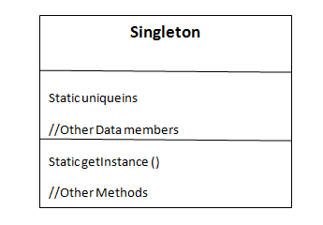

Slide 32
Sample Java Code

Slide 33
public class Singleton
{
private static Singleton uniqueins;
private Singleton() // Private Constructor
{
}
public static Singleton getInstance() // Class Method
{
if (uniqueins==null)
{
uniqueins= new Singleton();
}
return uniqueins;
}
}

Slide 34
class testsingleton
{
public static void main(String args[])
{
Singleton.getInstance(); // call to static method
}
}

Slide 35
Structural Patterns
Structural class patterns:
use inheritance to compose classes
Structural object patterns:
describe ways to assemble objects.

Slide 36
Adapter
Problem
How to resolve Incompatible interfaces,
or
provide a stable interface to similar components with different interfaces?
Notes:
https://www.youtube.com/watch?v=wA3keqCeKtM

Slide 37
Adapter – All Around Us
An adapter changes the interface of the outlet to what you expect

Slide 38
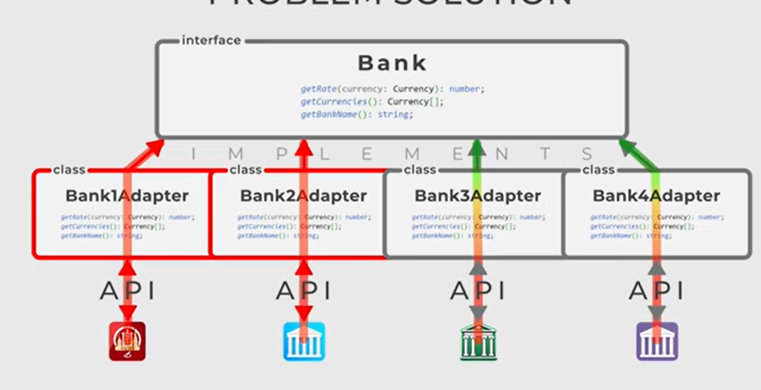
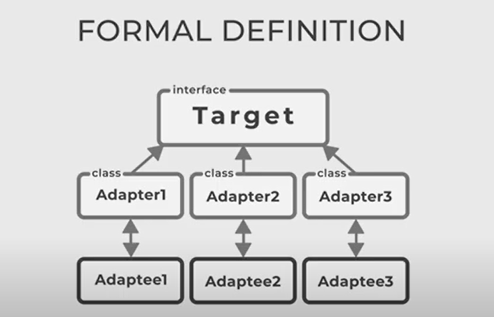

Slide 39
OO Adapters
The OO Adapters play the same role as their real world counter parts
They take an interface and adapt it to one that a client is expecting

Slide 42
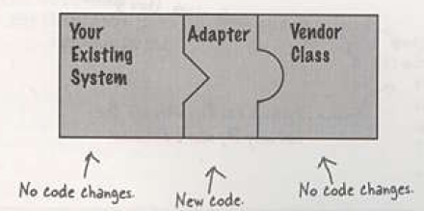
Adapter

Slide 43
Example:
An existing application computes the principal obtained from investing a given amount for a given number of years in a special type of investment, and we want to use this functionality.
In doing so however we want to modify our own application as little as possible.
We also want to be able to easily switch to alternate implementations of the required external functionality.

Slide 44
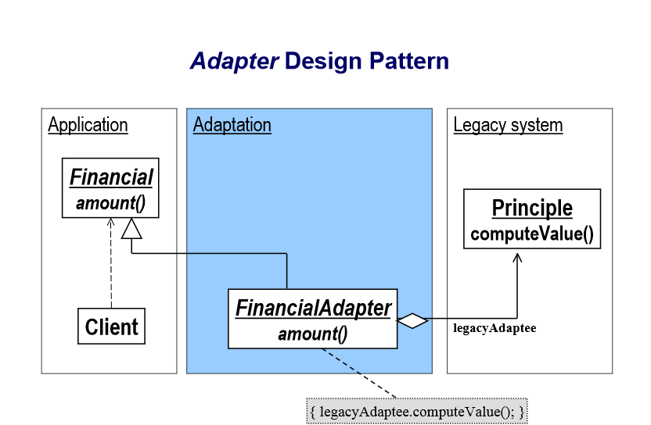
Example

Slide 45
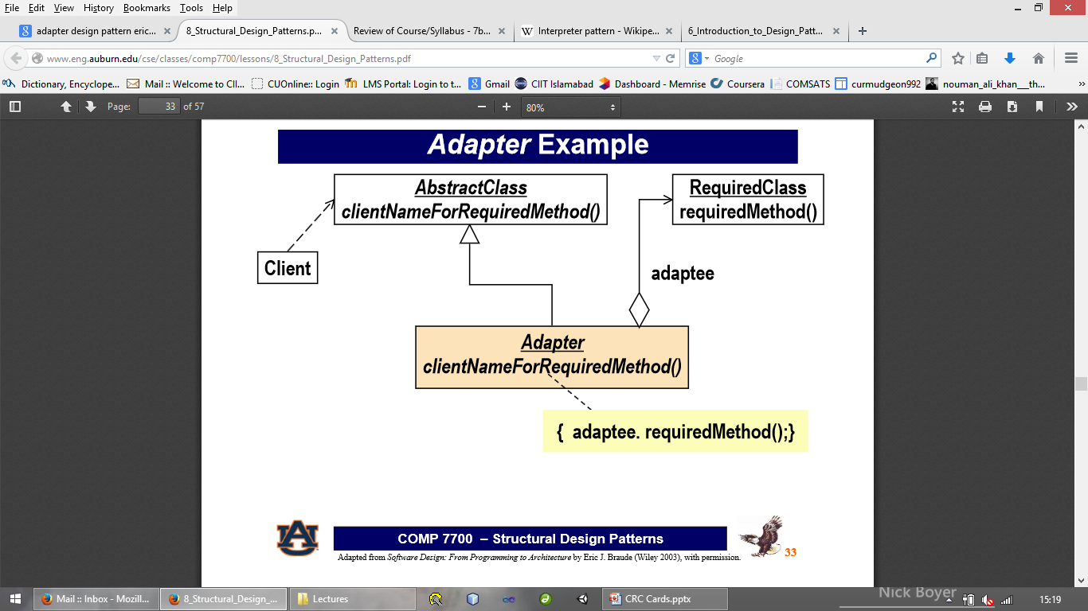
Class Diagram

Slide 46
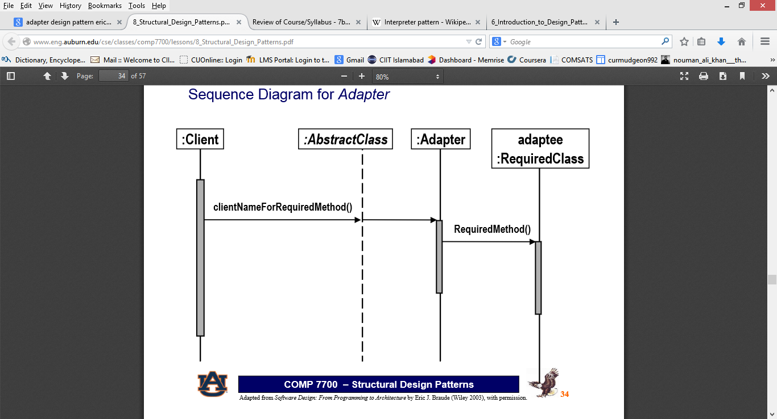

Slide 47
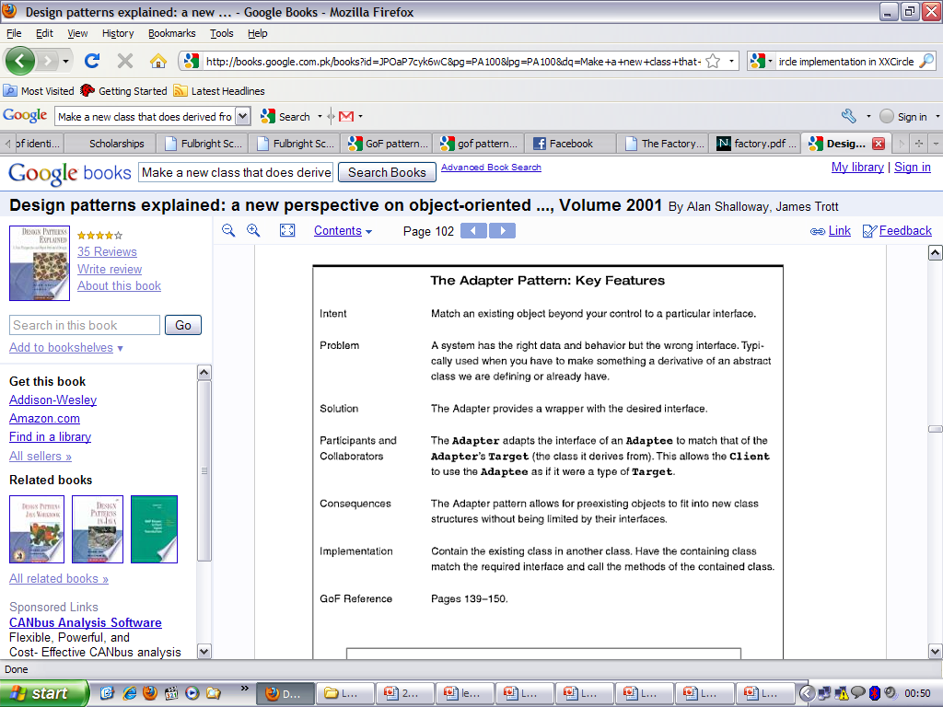

Slide 48
Behavioral Patterns
Characterize the ways in which classes or objects interact and distribute responsibility.
Behavioral class patterns:
use inheritance to describe algorithms and flow of control
Behavioral object patterns:
describe how a group of objects cooperate to perform a task that no single object can carry out alone.

Slide 49
Observer
Notes:
https://www.youtube.com/watch?v=-oLDJ2dbadA

Slide 50

Observer Design Pattern

Slide 51



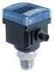

Weather Monitoring Application
Temperature sensor device
Weather forecast
Weather station
Weather data object
Current conditions
Pressure sensor device
Weather statistics
What we have
What we need to implement
Humidity sensor device
Notes:
Post office example, youtube example

Slide 52
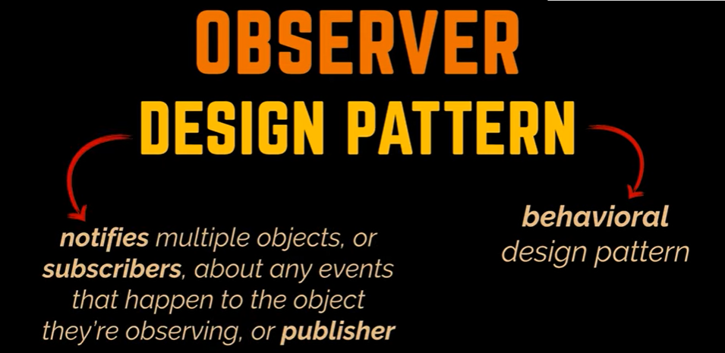

Slide 53
The Weather Data Object
WeatherData
These three methods return the most recent weather measurements for temperature, humidity and barometric pressure respectively
+ getTemperature()
+ getHumidity()
+ getPressure()
+ measurementsChanged()
We don’t care how this variables are set; the Weather data object know how to get updated info from the Weather station
/* This method gets called whenever the weather measurements have been updated */
public void measurementsChanged()
{
// your code here
}
Weather forecast
Weather statistics
Current conditions

Slide 54
The Weather Data Implementation
public class WeatherData
{
// instance variable declarations
public void measurementsChanged()
{
float temp = getTemperature(); float humidity = getHumidity(); float pressure = getPressure();
currentConditions.update(temp, humidity, pressure);
statistics.update(temp, humidity, pressure);
forecast.update(temp, humidity, pressure);
// other WeatherData methods here
}
}

Slide 55
The Weather Data Implementation
public class WeatherData
{
// instance variable declarations
public void measurementsChanged()
{
float temp = getTemperature();
Grab the most recent measurements by calling the WeatherData’s getter methods (already implemented)
float humidity = getHumidity();
float pressure = getPressure();
Call each display element to update its display passing it the most recent measurements
currentConditions.update(temp, humidity, pressure);
statistics.update(temp, humidity, pressure);
forecast.update(temp, humidity, pressure);
// other WeatherData methods here
}
}

Slide 56


The Weather Data Implementation
pub
{
lic class WeatherData
// instance variable declarations
public void measurementsChanged()
For every new display we need to alter the code
We have no way to add (or remove) display elements at runtime
The display elements don’t implement a common interface
We haven’t encapsulated the part that changes
{
float temp = getTemperature(); float humidity = getHumidity(); float pressure = getPressure();
currentConditions.update(temp, humidity, pressure);
statistics.update(temp, humidity, pressure);
forecast.update(temp, humidity, pressure);
// other WeatherData methods here
}
}

Slide 57

Publisher + Subscriber = Observer
When data in the WeatherData object changes the observers are notified
Weather forecast
Weather data object
New data values are communicated to the observers in some form when they change
Current conditions
Observer
objects
This object isn’t an observer so it doesn’t get notified when the subject data changes
Weather statistics
The displays have subscribed with the WeatherData
to receive updates when the Weather data changes

Slide 58

Adding Observers
A TV station comes along and tells the Weather
data that it wants to become an observer
Weather forecast
Weather data object
Current conditions
Observer
objects
register/ subscribe me
Weather statistics

Slide 59

The Weather Data Object
The TV station is now an official observer
It gets a notification when the Weather object
has changed
Weather forecast
Weather data object
Current conditions
Observer
objects
Weather statistics

Slide 60
Removing Observers
One of the displays asks to be removed as an
observer
Weather forecast
Weather data object
Remove / Unsubscribe me
Current conditions
Observer
objects
Weather statistics

Slide 61
Removing Observers
One of the displays asks to be removed as an
observer
Weather forecast
Weather data object
Current conditions
Observer
objects
Weather statistics

Slide 62
Observer Design Pattern
Intent
Define a one-to-many dependency between objects so that when one object changes state, all its dependents are notified and updated automatically.
Encapsulate the core (or common or engine) components in a Subject abstraction, and the variable (or optional or user interface) components in an Observer hierarchy.

Slide 63
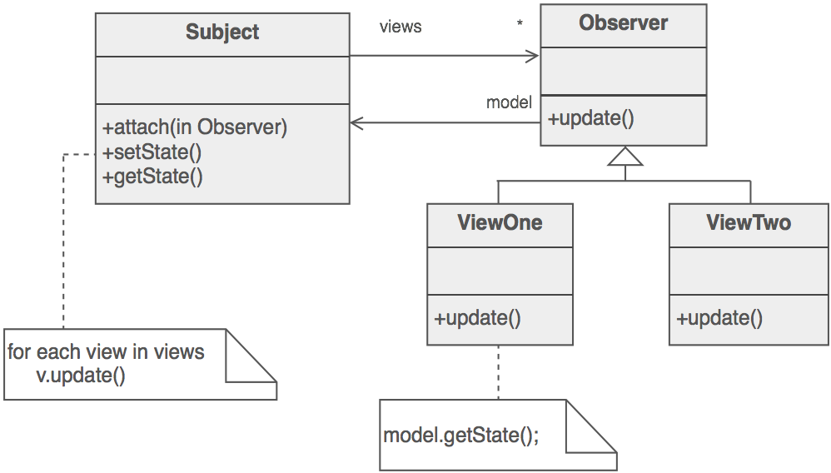

Slide 64
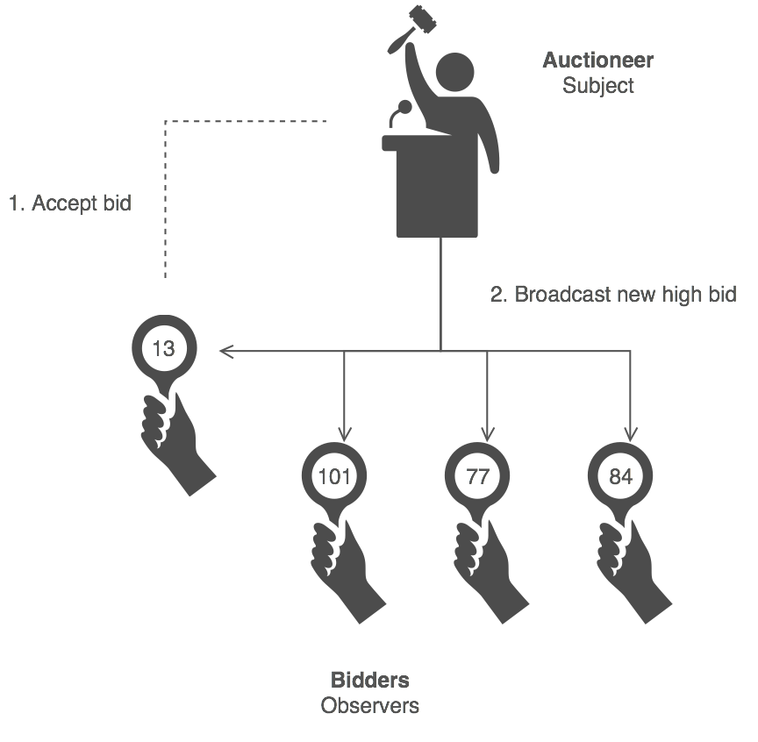

Slide 65
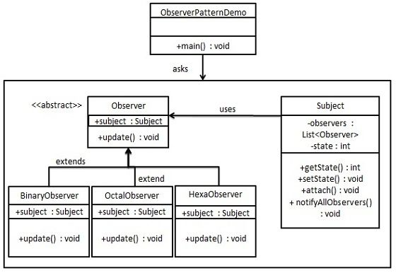

Slide 66
